Slide 1
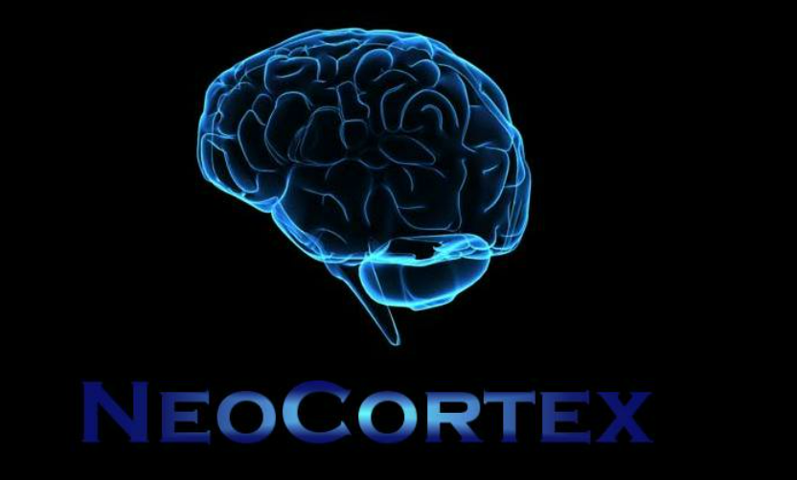
MULTI NUMBERS-IMAGE-SEQUENCE LEARNING
Gaurav Honnavara Manjunath - 1384178
Harish Palanivel - 1392283
Athkar Praveen Prajwal - 1394663

Slide 2
OBJECTIVE
A theoretical framework has been proposed for sequence learning in the cortex is known as Hierarchical Temporal Memory (HTM) sequence learning. This model using temporal memory can handle varying the sequences by keeping the predictions until valid evidence is available. HTM’s ability to predict future patterns arrive from learning which patterns are likely to follow each other. In scenarios when HTM receives a unique pattern, it compares historically received patterns with the new pattern.

Slide 3
TABLE OF CONTENTS
01
05
INTRODUCTION
LEARNING PHASE
02
06
METHODOLOGY
PROJECT FLOW
03
ENCODING
04
WORKING OF SPATIAL POOLER
07
RESULTS
08
CONCLUSION
09
REFERENCES

Slide 4

INTRODUCTION
Medical Science and ML engineers were working on the understanding of cortex for temporal pattern recognition.
HTM (Hierarchical Temporal Memory) has been proposed for sequence learning.
HTM is a biomimetics model based on the principle of memory predictions

Slide 5
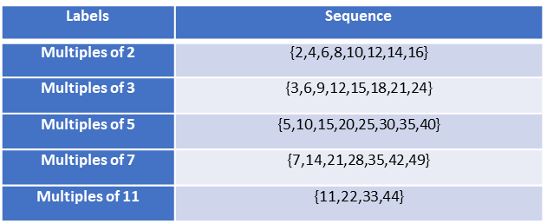
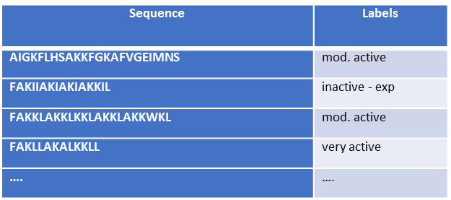
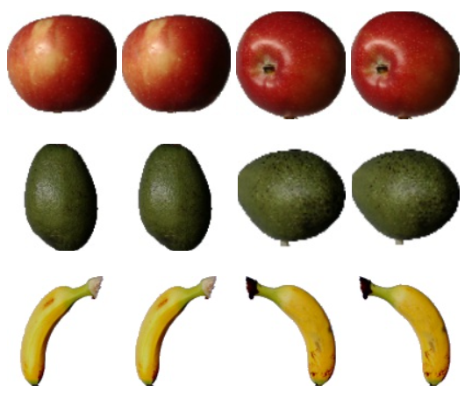
METHODOLOGY - DATASETS
NUMBERS
ALPHABETS
IMAGE

Slide 6

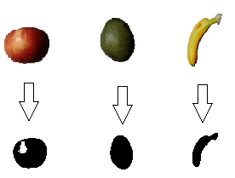
ENCODING
Image use HTM Image encoder
Numbers and Alphabets use Scalar encoder

Slide 7
WORKING OF SPATIAL POOLER
Creates SDR Input
Columns that are not active is not learnt
Each pattern that is appeared as input is compared with the database
Spatial Pooler
Temporal Memory
Classifier

Slide 8

LEARNING PHASE
For Numbers and Alphabets
Fetches datasets and train using Spatial Pooler
Homeostatic Plasticity Controller is used for Stability
Spatial Pooler trains each sequence for several iterations to attain stability
For Image
The datasets are fetched as .jpg file and is binarized using Encoder
Spatial Pooler is used to train the binarized datasets for several iterations

Slide 9
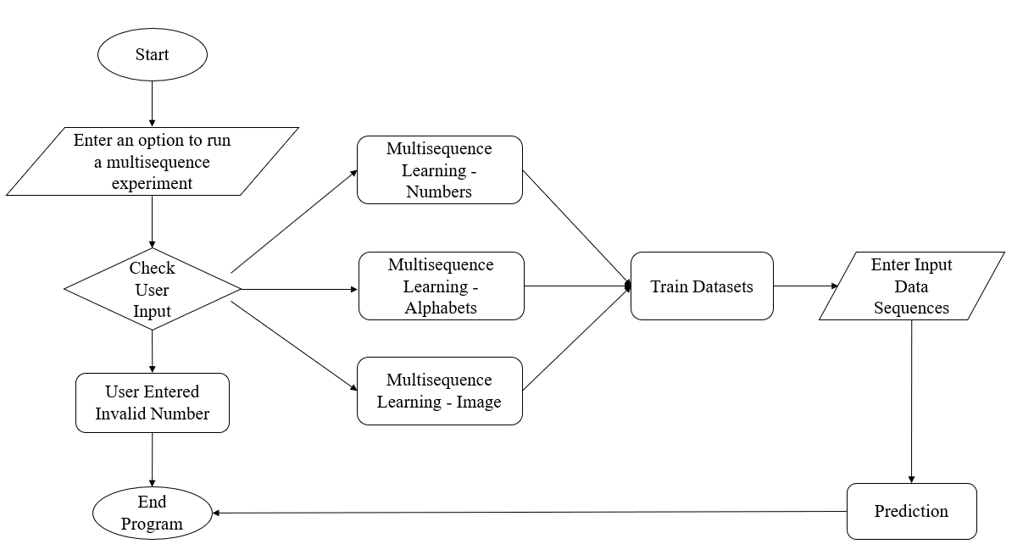
PROJECT FLOW

Slide 10
RESULTS
NUMBERS
ALPHABETS
IMAGES

Slide 11
CONCLUSION

Slide 12
REFERENCES
Keele, "“Sequence learning,” - B. A. C. G. J. D. S. W.," 1998. [Online]. Available: https://pubmed.ncbi.nlm.nih.gov/21227209
"D. V. B. Michael D Mauk, “Sequence learning,”," 2004. [Online]. Available: https://pubmed.ncbi.nlm.nih.gov/15217335
"B. H. J. L. R. .Rabiner, “An introduction to hidden markov models,”," 1986. [Online]. Available: http://ai.stanford.edu/~pabbeel/depth_qual/Rabiner_Juang_hmms.pdf.
Hawkins, "J. C. S. A. J. , “Continuous online sequence learning with an unsupervised neural network model,”," 2016. [Online]. Available: https://pubmed.ncbi.nlm.nih.gov/27626963
S. A. J. Hawkins, "“Why neurons have thousands of synapses, a theory of sequence memory in neocortex,”," 2016. [Online]. Available: https://www.frontiersin.org/articles/10.3389/fncir.2016.00023/full.

Slide 13
THANK YOU TEAM NOOBIES

